Slide 1
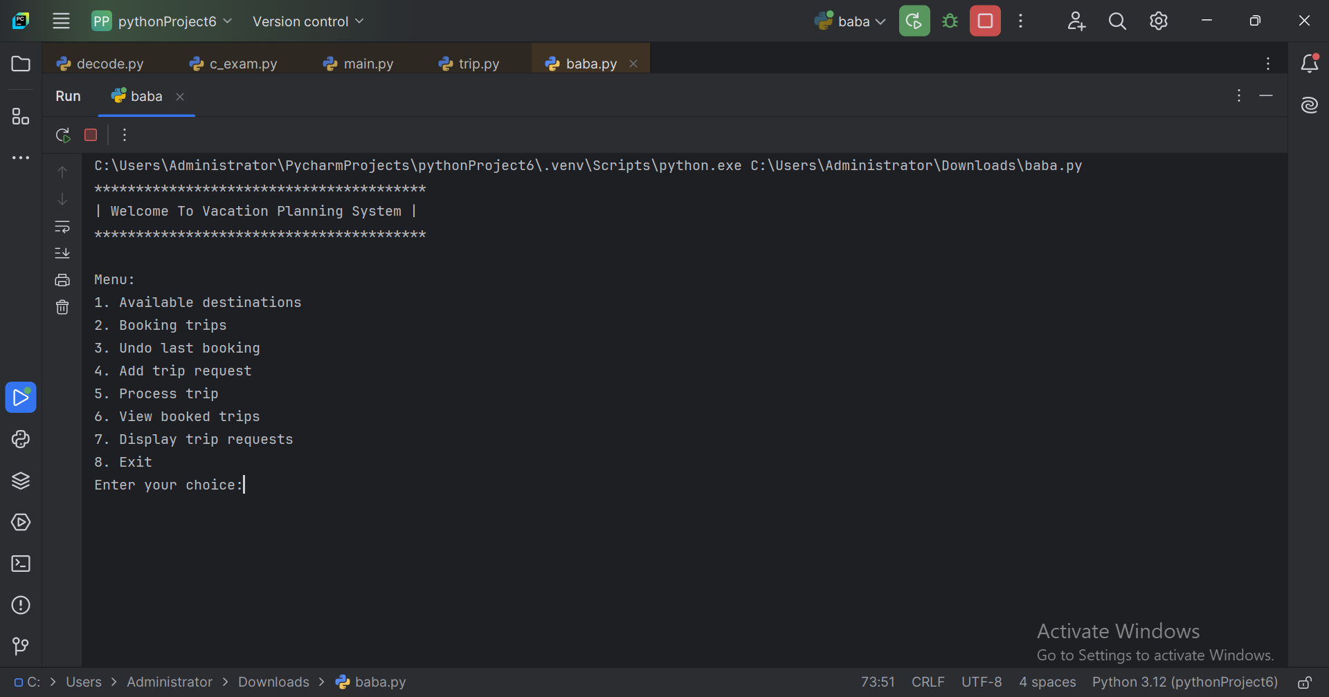
User interface using to do operations
write here option like 1

Slide 2
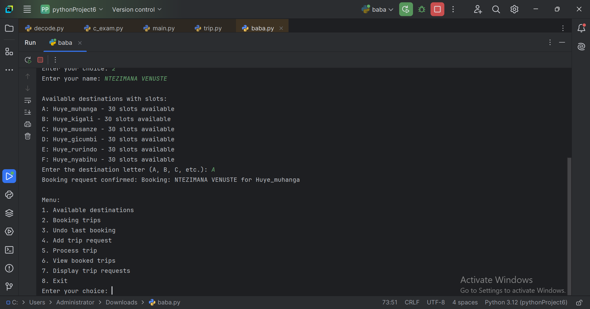
The booking operation allows a user to select a destination by its letter (e.g., "A" for Huye_Muhanga) and book a trip If there are available slots, the trip is confirmed, and the available slot count for the selected destination decreases by 1

Slide 3
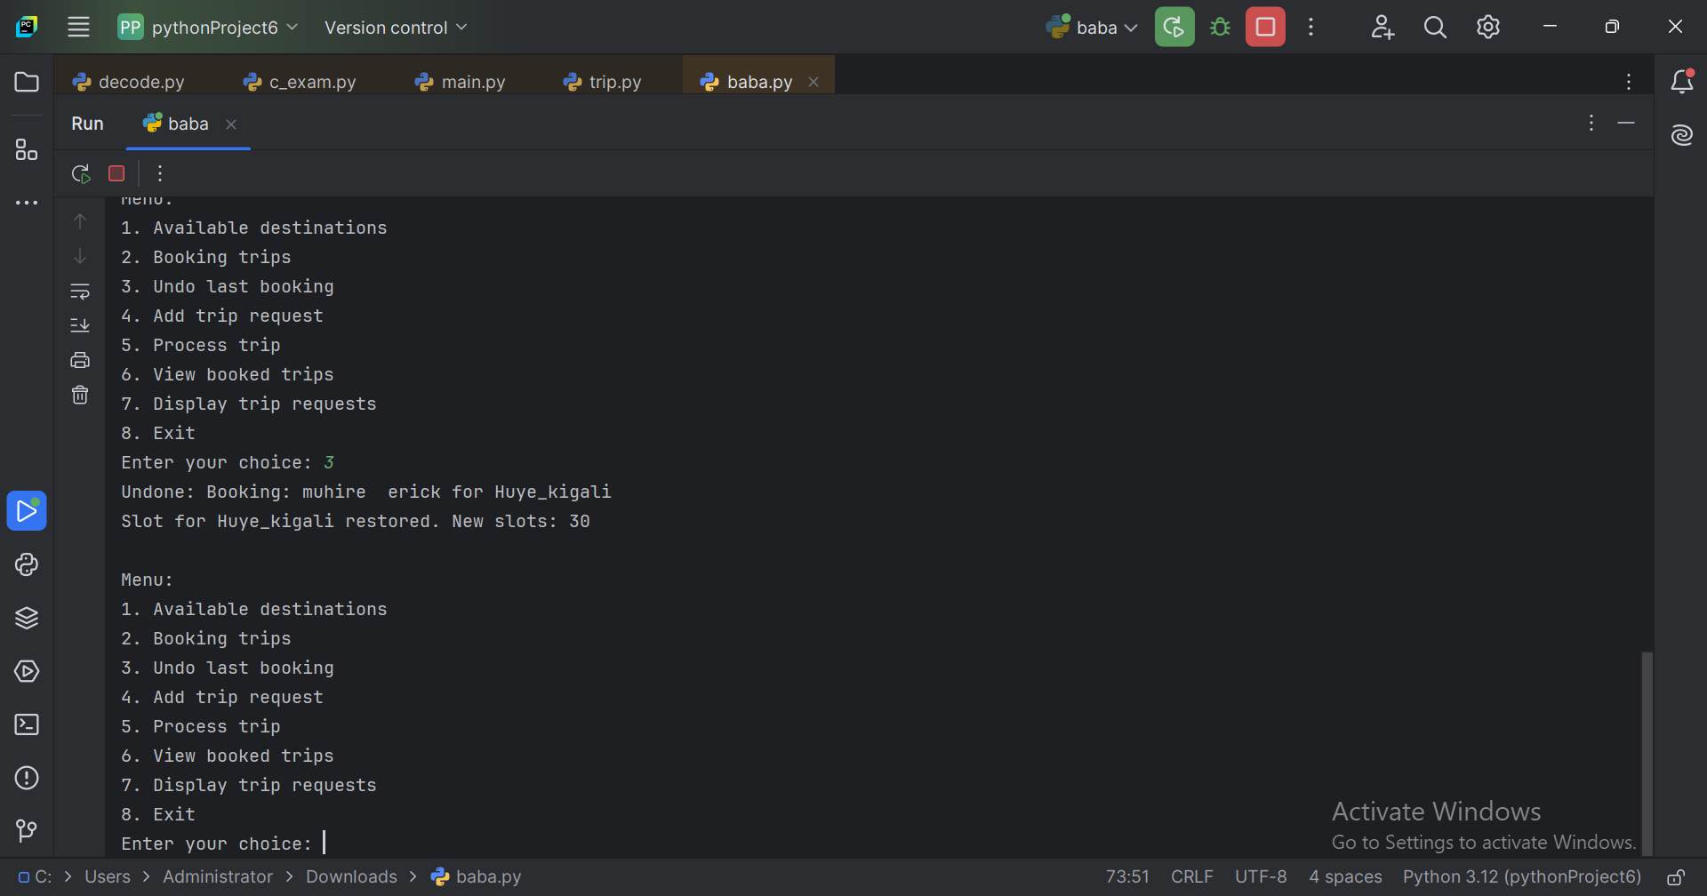
The undo last booking operation removes the most recent booking from the list and restores the available slot for the corresponding destination by increasing it by 1. This effectively "cancels“ the last booking and makes the slot available again.

Slide 4
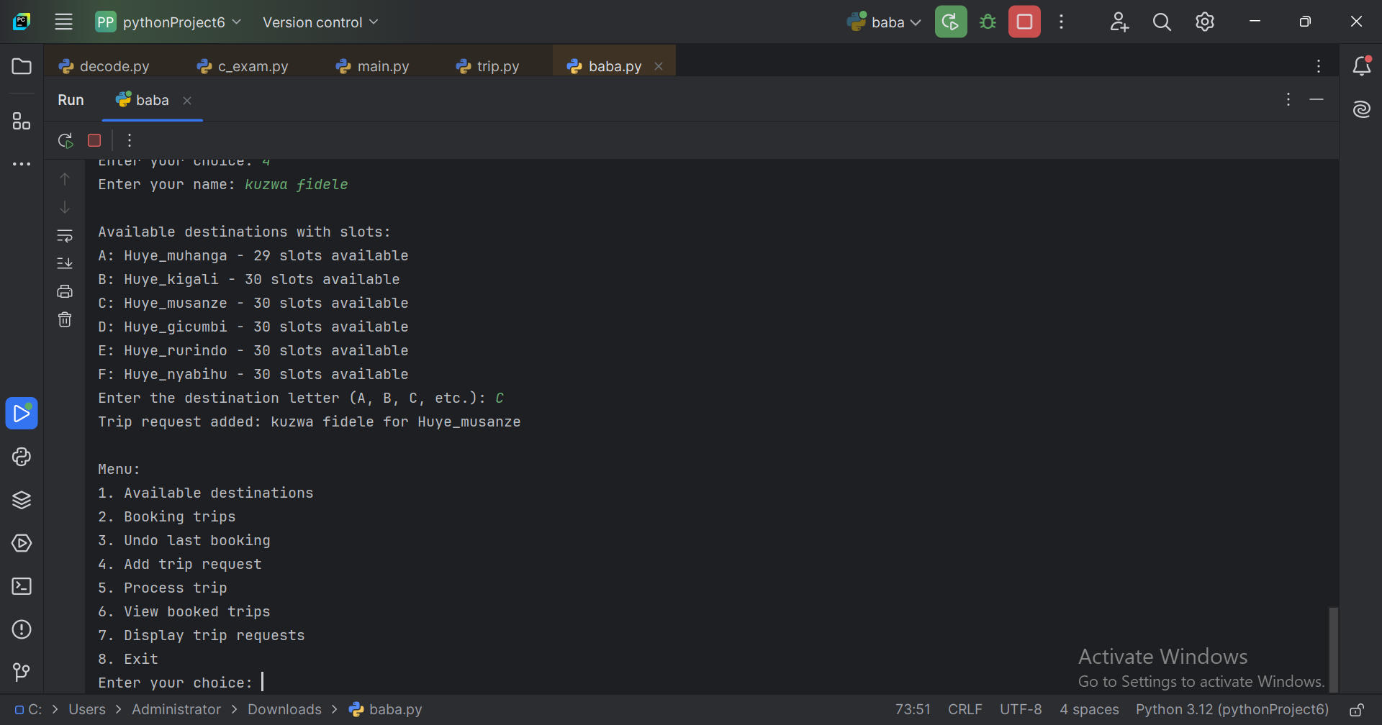
The add trip request operation allows a user to submit a request for a trip by selecting a destination. The request is added to a queue but does not affect the available slots until it is processed.

Slide 5
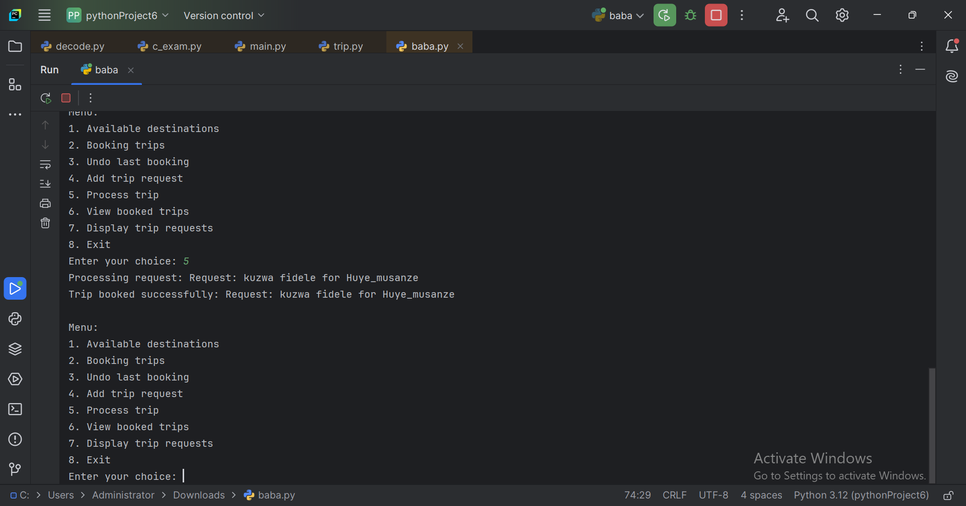
The Process Request option in this system handles the next trip request in the queue. It checks if the destination has available slots, books the trip if possible, and moves the request from the queue to the list of booked trips.

Slide 6
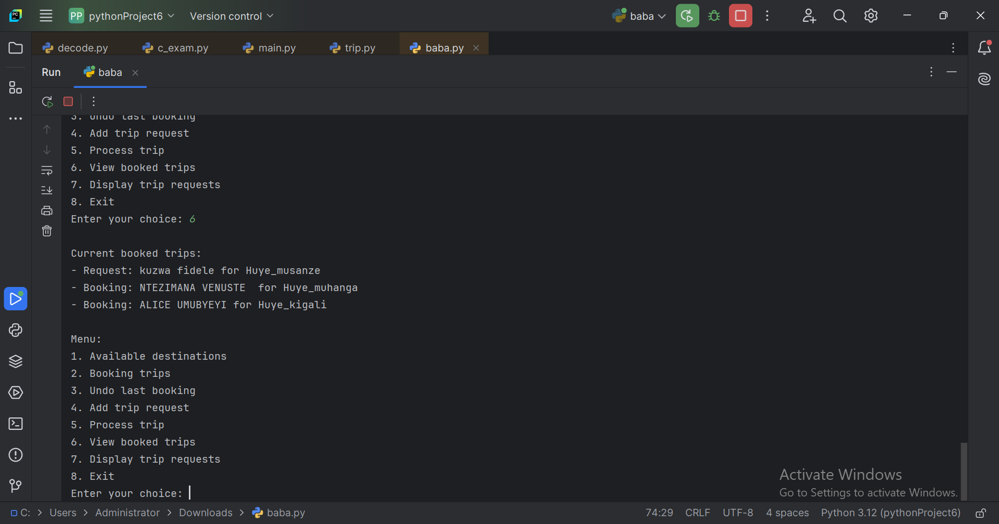
The View Booked Trips option displays a list of all trips that have been successfully booked, showing the names and destinations of each booking.

Slide 7
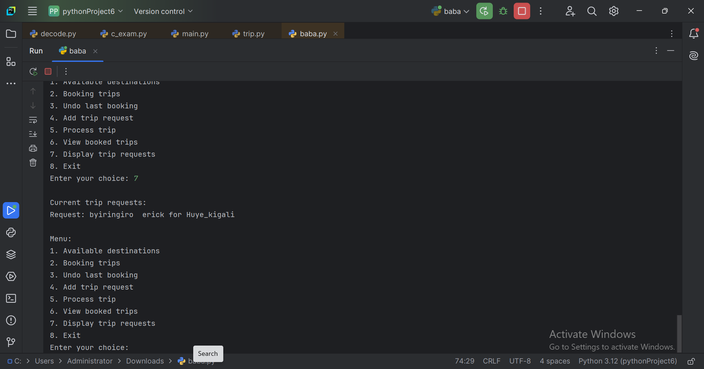
The Display Trip Requests option shows all the trip requests currently in the queue, waiting to be processed.

Slide 8
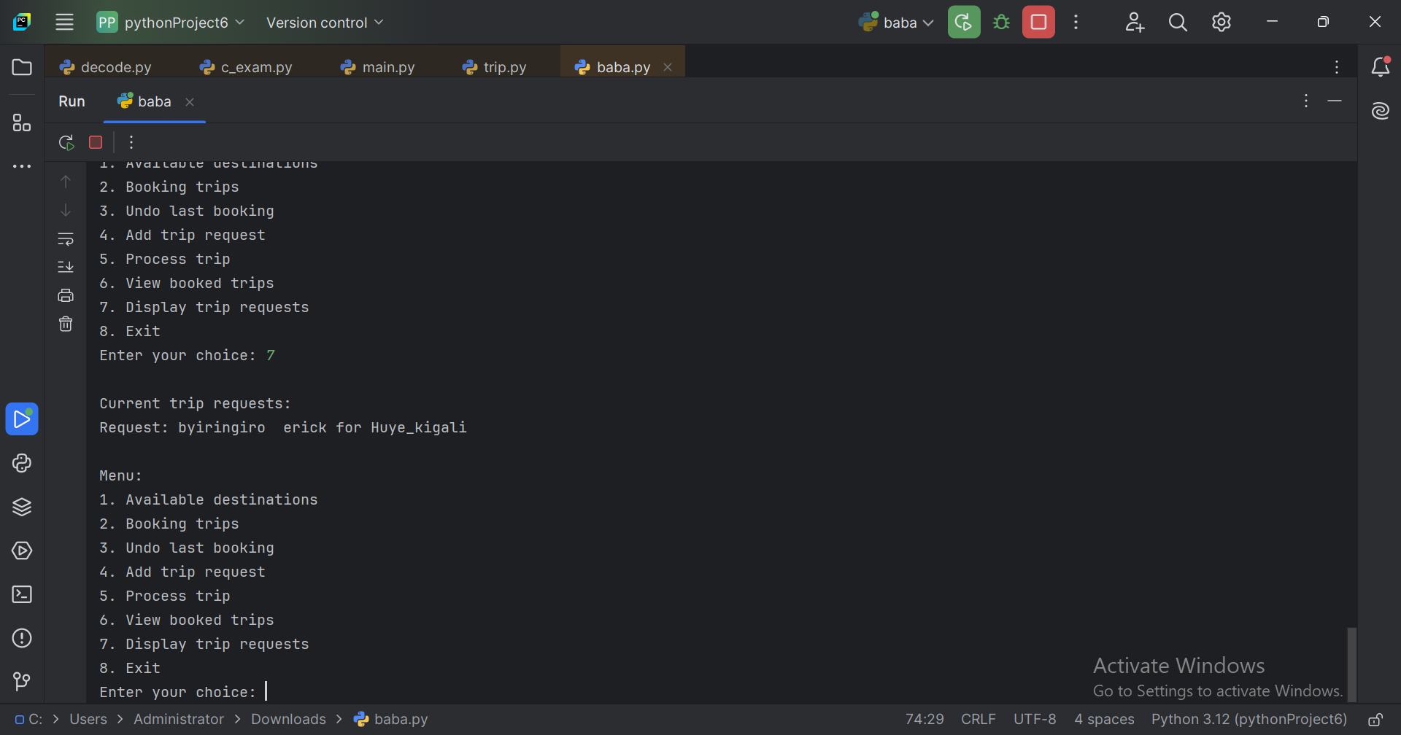
The Exit option terminates the program, ending the session with a farewell message.

